Slide 1
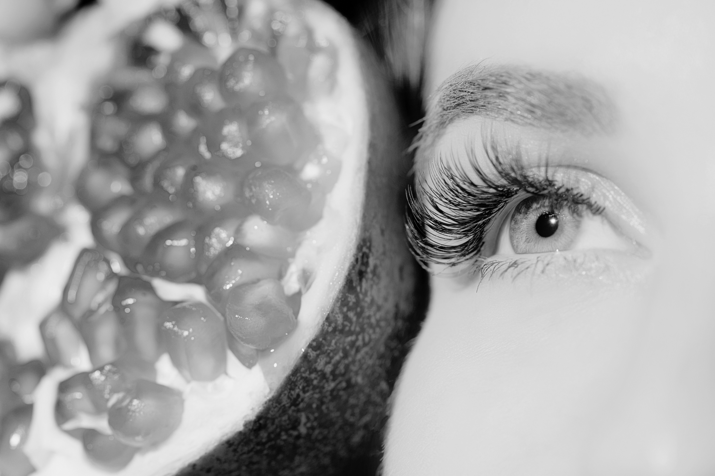

ANNUAL GENERAL MEETING 2026
THURSDAY JULY 16TH

Slide 2
ANNUAL GENERAL MEETING 2026 AGENDA
Ordinary Business | Report & Accounts Y/E 31.10.25 | For approval
 | Auditors report and reappointment | For approval
Special Business | Appointment of new Director | For approval
H&BA 2026 Update | Overview of activities and priorities for 2026 | For info & discussion

Slide 3
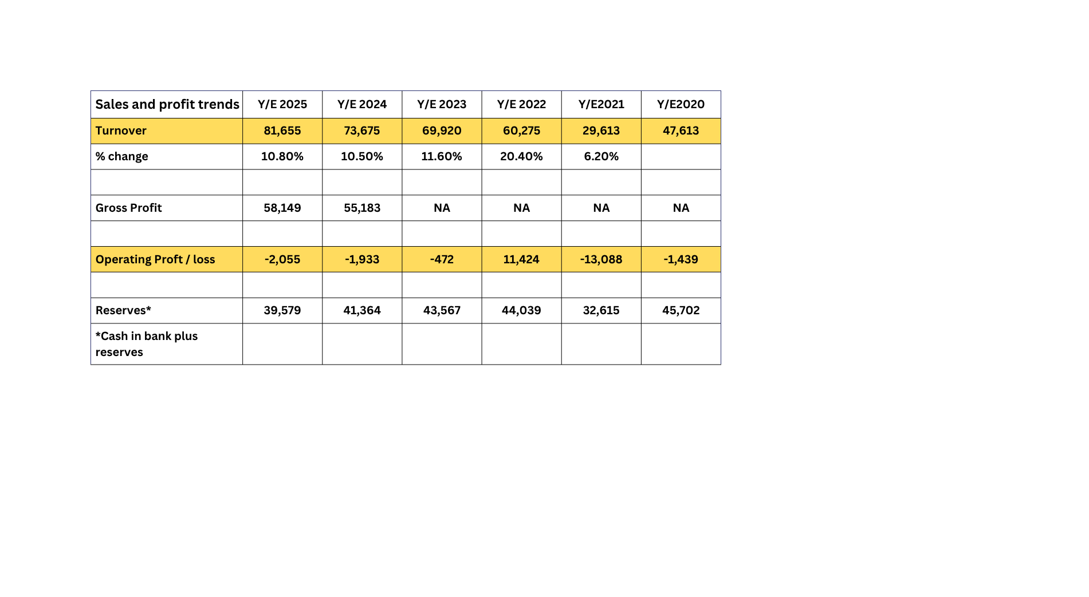
Sales & Profit
Turnover for the year has increased from 2025, with a total of £81,655 (2024: £73,675). Seminar expenses have increased, giving a gross profit of £58,149 (2024:£55,183). The overheads are very similar to last year at £59,822 (2024: £57,116, with increases in post and stationery and IT costs (due to website costs) and decreases in travel and accountancy.
Accountancy was overstated by £1,150 and we have corrected this, reducing the figure in 2025. In 2024 it should have been £1,230 and 2025 would have been £1,330 which would have been more comparable.
As a not-for-profit organisation, it remains the aim of the H&BA to operate with strict controls whilst delivering and building membership services, and for 2025 the annual Membership fees were held at £950 +vat, which has been in place since 2022.

Slide 4
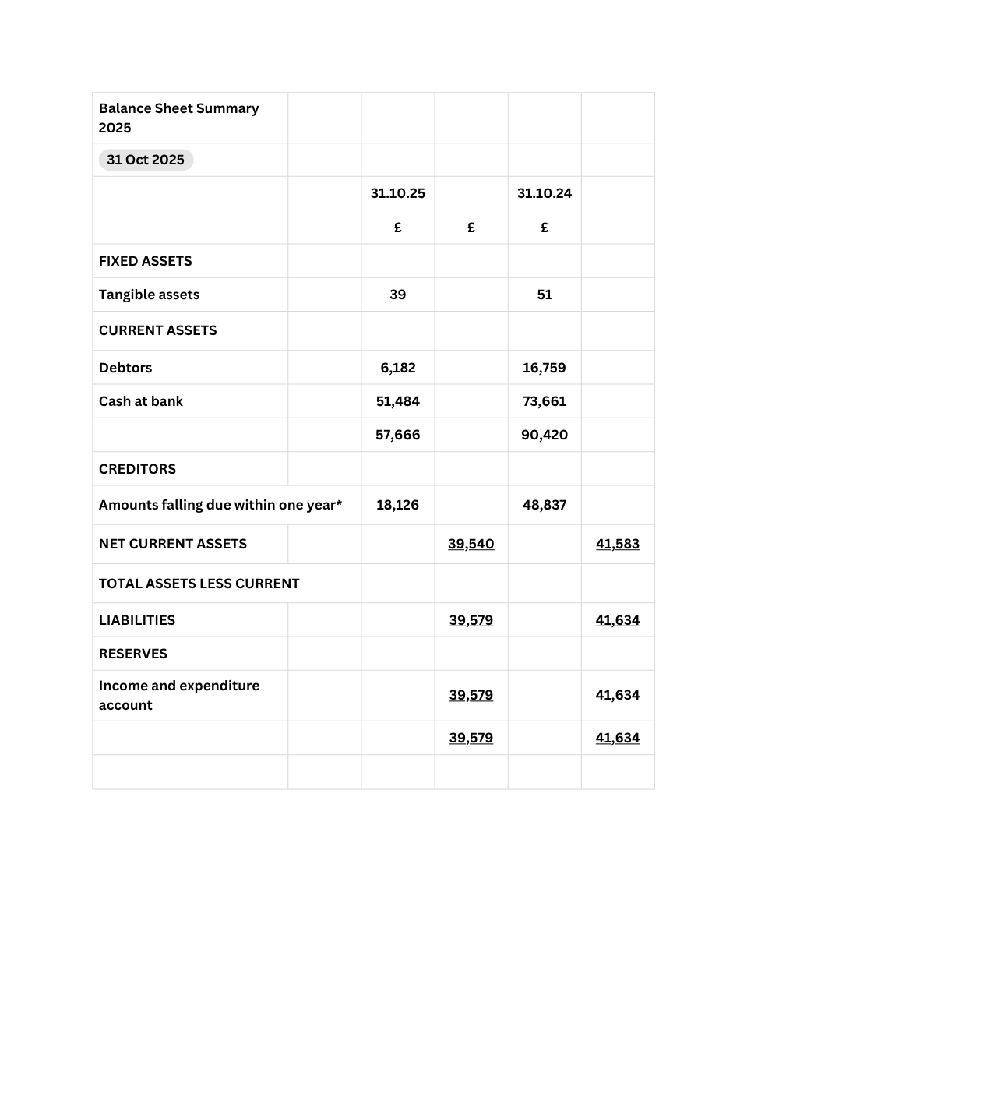
Balance Sheet
We have carried forward the proportion of the income that relates to the period beyond 31st October like last year, and that amount is £16,871 (2024:£20,793), shown in deferred income, this decreases from last year as the figure used in the 2024 accounts was gross rather than net.
Overall, there was a deficit of -£2.055 (2024: -£1933) reducing the reserves carried forward to £39,579 (2024: £41,634)
Accounts Approved By Janette Block
Accounts Seconded By Trevor Gore
Auditors report Approved By Janette Block
Auditors report Seconded By Trevor Gore

Slide 5

Ratifying the re-appointment of the Accountants and Auditors
5th year in place, local, cost effective and professional
Appointment proposed by; David Mitchell
Appointment seconded by; Janette Block

Slide 6
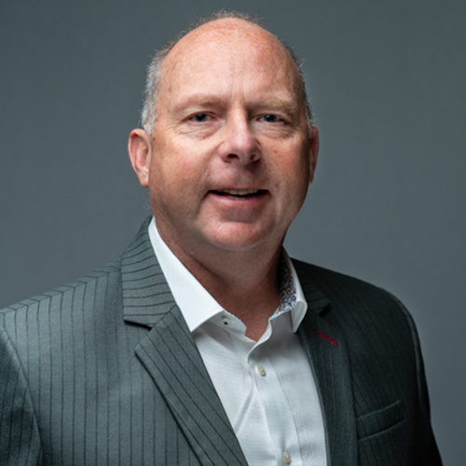
Board of Directors Appointments
Sincere thanks to Martyn who is taking a step back from the H&BA Board!
Remaining at Infirst, Martyn will continue to be a passionate ambassador for the H&BA and has proposed a replacement from Infirst Ltd to join the Board

Slide 7
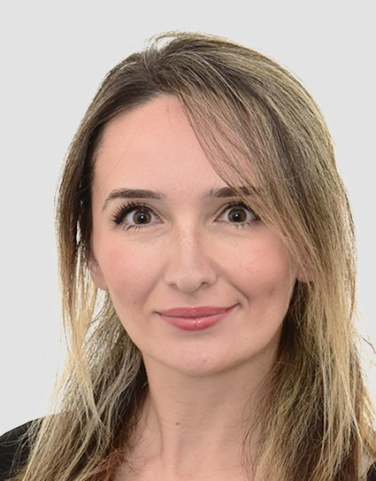
Board of Directors Appointments
Berin Kan Kamer of Infirst Ltd has been nominated to join the H&BA Board, as a representative of a manufacturing member company, as of 16.07.26.
Status
The current Board Members have approved this change and this requires ratifying at the AGM today
Board appointment of Berin Kan Kamer
    Appointment proposed by; Janette Block
    Appointment seconded by; Trevor Gore
Head of Consumer & Healthcare Marketing – Berin Kan Kemer
Berin is responsible for the consumer and healthcare professional marketing of Flarin. Bringing over 10 years of experience in FMCG and pharmaceutical marketing she joined Infirst in April 2024. She started her career in Turkey in regulatory affairs and transitioned into Marketing. She worked for Eczacıbaşı for several years and later continued her career in the UK with Reckitt. Berin has expertise in developing marketing strategies, managing diverse product portfolios. Berin holds a Bachelor of Science degree from the Faculty of Pharmacy at Ankara University, earned in 2010, and is a member of the Turkish Professional Chamber of Pharmacy.

Slide 8
Overview of activities and priorities for 2026
Financials YTD
Membership overview
Spring digital event series
Conference overview
YTG Priorities

Slide 9
Finance & Ops
2026 YTD Nov 25 - June 26
    Sales YTD
      £72.4k
      Membership fees 76%
      Other sales (conference tickets, sponsorship) 24%
    Key spending trends
      Conference was slightly below break-even. Higher delegate ticket prices largely offset impact of higher Dinner costs.
      All other overheads running at similar ratios to last year
    Chasing 2 members for late payment of annual fees (3% / £2.5k)

Slide 10
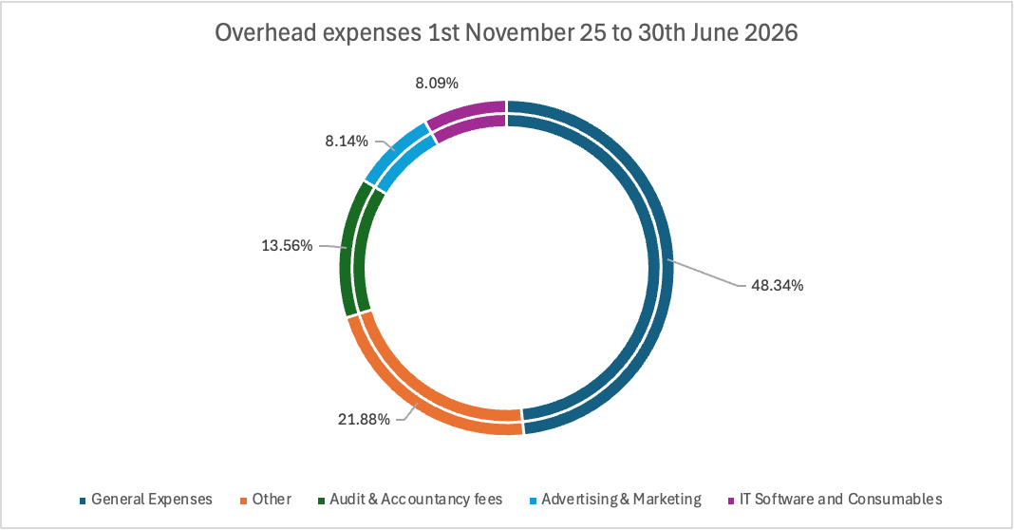
Finance & Ops YTD 26
YTD Overheads £31k running in similar ratio’s to last year

Slide 11
Finance & Ops YTD 26
  Moved H&BA to XERO Accounting system for financial reporting, analysis and forecasting in June. One off set up costs.
    Efficiency & accuracy versus manual entry spreadsheets
    Future cost savings (vat, outsourcing)
    Invoicing capability
  People update: Jess Teague, Pixel & Glitch on Maternity leave for July and August. Will return to some part-time work in September.

Slide 12
Membership Update
  Invoiced Members count YTD was 56 (excluding affiliates and partners)
    Current count 55
    New 3 (+5%) (Salitix, Cambridge Healthcare, Covestus)
    Lost 4 (-7%) (Bausch & Lomb, Dr Organic, EM Pharma, Nelsons)
    Main reasons for loss; not making use of content, budget restrictions.
    All lost members previously ‘flagged’ as risk
  YTG priorities
    Review Membership categories / access
    Optimise email database & contact strategy
    Update website for non-members
    Recruit new members (Beauty Awards, Conference attendees)

Slide 13
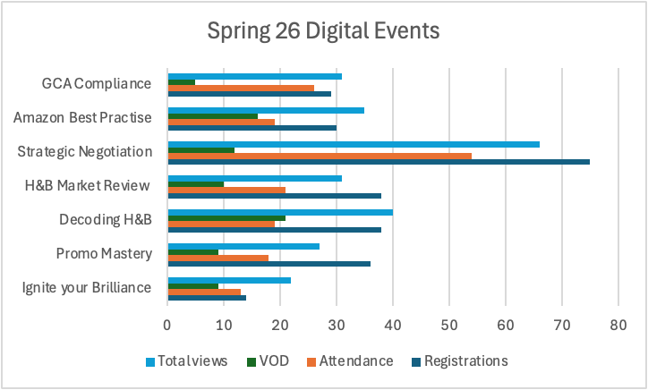
Digital Events
Key Learnings from Spring 26 event
  Participation varied widely depending on topic (Best 66, Worst 22, Average 36)
  Registrations rose with multiple email reminders
  Foundational commercial skills, market and retailer insights clear winners
YTG Priorities for Autumn series
  ‘Less is more’
  Skills based
  2 insights presentations
  Retailer masterclass
Longer-term decision re event format and digital ‘wear out’

Slide 14
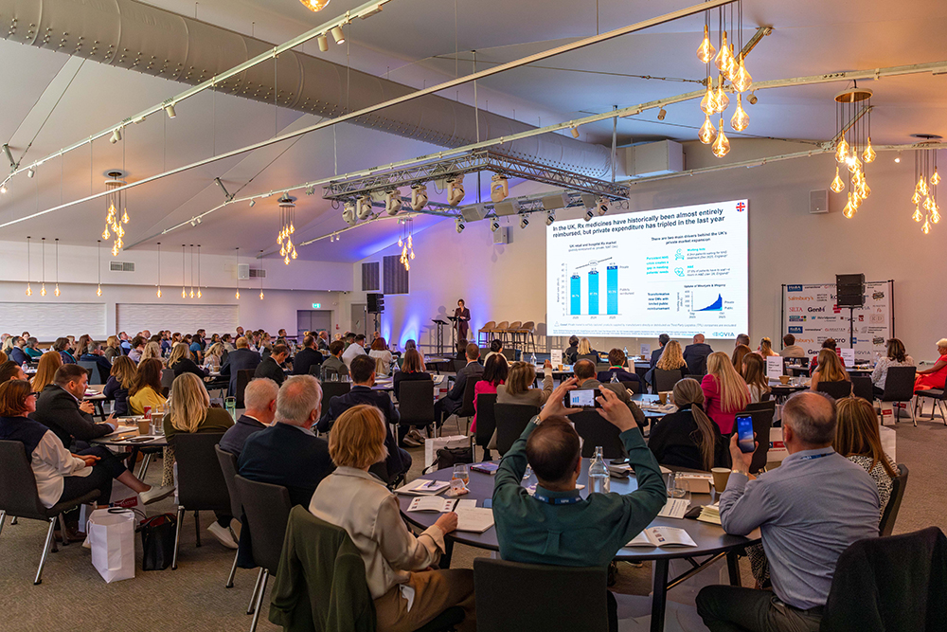
Conference 2026

Slide 15
132 delegates from 45 H&B businesses attended the conference in May!
Overwhelmingly positive feedback from the 22 survey respondants, highlighting
commercial relevance
high-quality networking opportunities
timely focus on emerging industry trends
100% of respondents rated the event Beneficial or Very Beneficial and would attend again and reccommend to others!
”
“A great networking event with good content”
“Insightful and thought provoking”
“Brilliantly constructed event.”

Slide 16
Conference 2026
Session Feedback Themes
Daniel Rowles Practical AI insight, strategic thinking, highly engaging
TikTok Shop Playbook Social commerce growth, future retail trends
Sainsbury’s Retail transformation, commercial insight
IQVIA Data, market intelligence, healthcare evolution
Gen M / Worldpanel Emerging category opportunity
Minster FB / Amazon Marketplace strategy, ecommerce growth
“AI needs to move from tactical curiosity to strategic capability”
“TikTok deserves serious attention, especially in beauty”
“Growth doesn’t come from more – it comes from how well we connect what we already have”
“The amazing shift in beauty retailing being implemented by Sainsbury’s”

Slide 17
Conference 2026
Suggestions for future topics
AI and operational transformation
Retailer playbooks and expectations
Data and commercial strategy
Social and Digital commerce
Leadership & workforce trends
Areas for improvement
Presentation length
Action orientated content
increased audience participation
AV / Room logistics
“The next evolution could be to balance ‘interesting things we should all be aware of’ with more commercial moves we should make on Monday morning.’”
“Well curated, commercially relevant, and with enough new thinking to make the journey worthwhile.’”

Slide 18
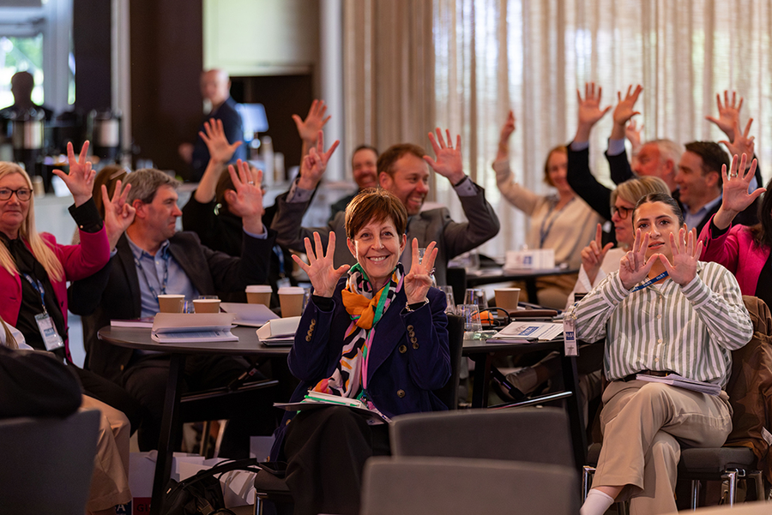
Conference 2026
Strategic Takeaways for H&BA
Delegate facing
  Continue leading on emerging trends
  Move toward more practical implementation
  Increase interactivity & intelligence gathering
  Retailer participation key
H&BA
  Optimise sponsorship opportunities
  Event format & venue review

Slide 19
Overall YTG Priorities
  Autumn Digital Events ‘fewer, bigger, better’
  Conference 27 strategy & planning
  Move GSCOP request forward via the CMA
  Membership Strategy
    Recruitment (Beauty Awards, website updates, LinkedIn, follow ups with conference attendees)
    Contact strategy
    Tiering

Slide 20
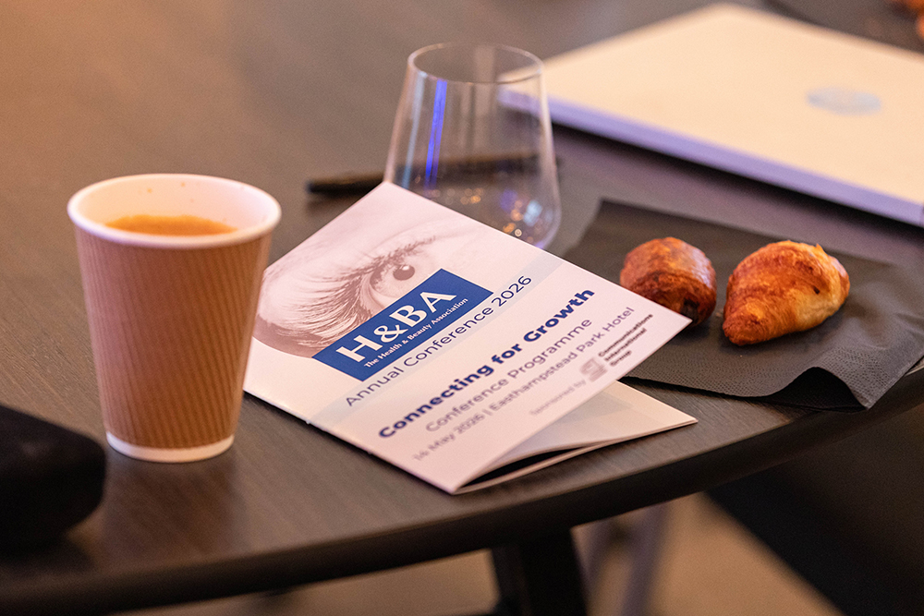
Thank you! Any questions?

